Slide 1

Smart Traffic Signal Optimization System
Presented by : G.RAJU(192411065)
GAYATHRI DEVI .M.S(192421279)
P.SAI BHARGAV(192411049)
EESHA(192311261)
Subject code: CSA0618
Subject: DESIGN ALGORITHM & ANALYSIS
Guide name: Dr. GNANAJEYARAMAN RAJARAM

Slide 2
PROBLEM STATEMENT
Traffic congestion is one of the most common problems in urban areas, resulting in increased travel time, fuel consumption, and air pollution. Conventional traffic signal systems use fixed signal durations regardless of the actual traffic conditions, making them inefficient during peak hours. Roads with heavy traffic often experience long waiting times, while roads with fewer vehicles receive unnecessary green signal time.
This imbalance reduces the efficiency of traffic movement and creates bottlenecks at intersections. Therefore, there is a need for a smart system that can monitor traffic in real time and optimize signal timings based on current road conditions.

Slide 3
ABSTRACT
Traffic congestion has become a major challenge in urban areas due to the increasing number of vehicles on the roads. Traditional traffic signals operate on fixed timings, which often leads to unnecessary delays and traffic jams.
The Smart Traffic Signal Optimization System is designed to overcome this problem by using real-time traffic information such as vehicle count, waiting time, and traffic density.
The collected data is analyzed to determine the most efficient signal timings for each intersection. The system dynamically adjusts traffic lights according to current traffic conditions, reducing congestion and improving vehicle movement.

Slide 4
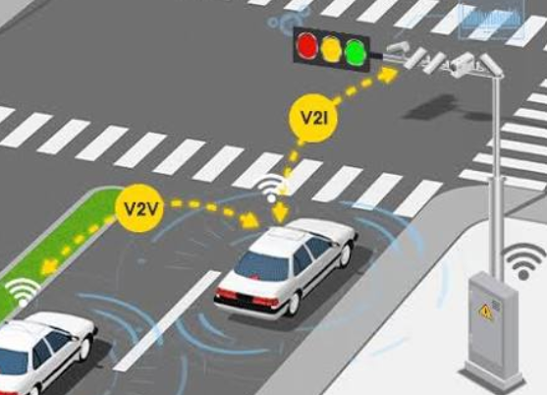
INTRODUCTION
Traditional traffic signals use fixed timings regardless of traffic conditions.
During peak hours, fixed timings often lead to long queues and traffic congestion.
Smart traffic systems overcome this issue by responding to real-time traffic data.
The proposed system continuously monitors road conditions and adjusts signal timings dynamically.
It helps reduce delays, improve travel time, and increase road efficiency.

Slide 5

OBJECTIVE
The main objective of this project is to develop a smart traffic management system that automatically adjusts traffic signal timings based on real-time traffic conditions.
The system aims to collect accurate traffic data, analyse congestion levels, and allocate green signal time efficiently.
It focuses on reducing vehicle waiting time, minimizing traffic congestion, and improving the overall flow of vehicles at intersections.
Another objective is to reduce fuel consumption and vehicle emissions caused by unnecessary idling.
The project also aims to provide a scalable and intelligent solution that can be implemented in smart cities to improve transportation efficiency.

Slide 6
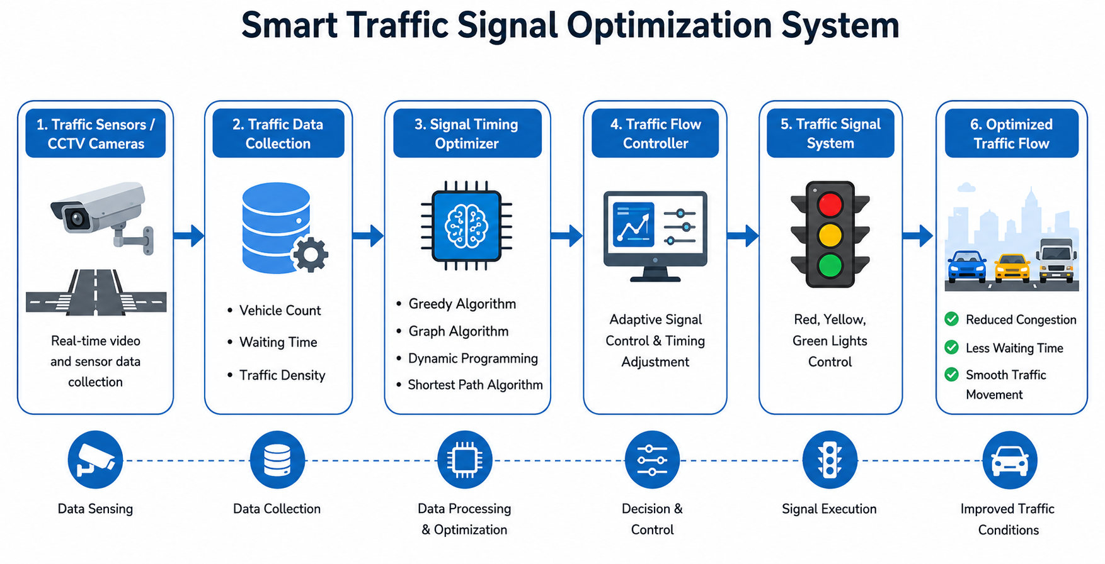
ARCHITECTURE DIAGRAM

Slide 7
MODULE 1:TRAFFIC DATA COLLECTION
Collect real-time traffic data using cameras, sensors, or IoT devices.
Count the number of vehicles on each road approaching the intersection.
Detect traffic density and congestion levels.
Send the collected traffic information to the optimization module for processing

Slide 8
MODULE 2:SIGNAL TIMING OPTIMIZER
Analyze the traffic data received from the data collection module.
Calculate the optimal green, yellow, and red signal durations.
Prioritize roads with higher traffic density to reduce waiting time.
Update signal timings dynamically based on changing traffic conditions.

Slide 9
MODULE 3: TRAFFIC FLOW CONTROLLER
Control traffic lights according to the optimized signal timings.
Continuously monitor traffic flow and adjust signals when required.
Handle emergency vehicle priority by providing faster green signals.
Ensure smooth traffic movement while minimizing congestion and delays.

Slide 10
MODULE 4: TRAFFIC MONITORING & ALERT SYSTEM
Monitor the performance of traffic signals and overall traffic flow in real time.
Detect unusual conditions such as traffic jams, accidents, or signal malfunctions.
Generate alerts for traffic authorities when abnormal situations are identified.
Store traffic data and system logs for future analysis, reporting, and performance improvement.

Slide 11
LIMITATIONS
Accuracy depends on the quality of traffic sensors and cameras.
High installation and maintenance costs for smart infrastructure.
Network or power failures can affect system performance.
Less effective in areas without IoT-enabled traffic systems.
FUTURE SCOPE
Integrate AI and Machine Learning for predictive traffic management.
Support V2I (Vehicle-to-Infrastructure) communication for connected vehicles.
Provide automatic priority for emergency vehicles.
Expand the system to coordinate multiple intersections in smart

Slide 12
RESULT
Successfully collected and analyzed real-time traffic data.
Optimized signal timings based on traffic density.
Reduced vehicle waiting time and traffic congestion.
Improved traffic flow and intersection efficiency.
Demonstrated a scalable solution for future smart city traffic management.

Slide 13


